Slide 1
IBM Capstone – Battle of the Neighborhoods
By Ashwin Gupta

Slide 2
Business Problem
Our aim for this project is to find suitable locations to open an Italian restaurant in New Delhi, India.
In order to do this we will try to find areas that aren't too crowded with restaurants in general, as well as having no Italian restaurants in its vicinity. On top of this we don't want the locations to be too far away from the city center.
This will be useful for stakeholders who want to open a successful Italian restaurant in New Delhi, India, as it will provide them with filtered locations of low competition to being a more in depth evaluation of suitable locations considering additional factors.

Slide 3
Data
The data the we need according to our stated business problem is:
Number of restaurants in a neighborhood.
Number and distance of Italian restaurants in a neighborhood.
Distance of neighborhood from city center.
In order to define the aforementioned neighborhoods, a circular grid system centered around the city center was used.
To obtain the data, the following data sources are required:
The neighborhood locations will be generated algorithmically, and corresponding addresses will be acquired using the Geopy library.
The data on restaurants will be obtained using the Foursquare API.

Slide 4
Methodology
This project looks at the 20km radius around the center of New Delhi in order to identify areas that have a low restaurant density as well as a low number of Italian restaurants.
Firstly, we have collected the required data: Location of all restaurants as well as specifically identifying which of those are Italian restaurants within 20km of the center of New Delhi.
Secondly, we will visualize this data as heatmaps in order to explore the density of restaurants in New Delhi. This will lead to the identification of areas with low density that are close to the center.
Finally, the most promising area will be selected and further analyzed in order to create clusters using K-means of suitable locations that abide by the following requirements: no more than two restaurants within a 1km radius and no Italian restaurant within a 1.5km radius. This will yield general areas for further exploration by stakeholders in order to identify where to open an Italian restaurant.

Slide 5
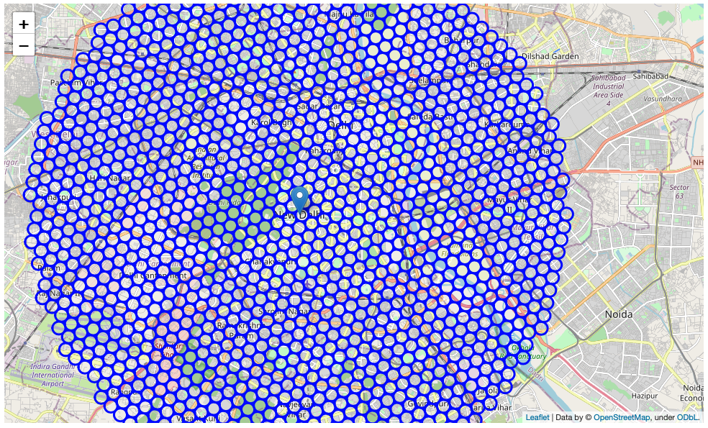
Data: Generated Neighborhoods Grid
Algorithmically generated grid

Slide 6
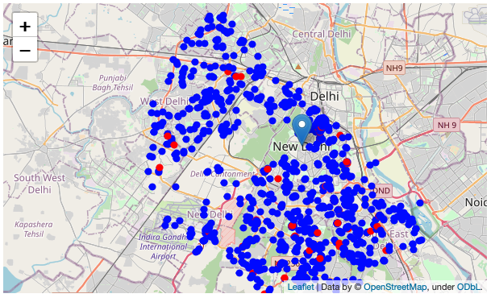
Restaurant Data from Foursquare API
Visualized on a map
Blue is restaurants
Red is Italian restaurants

Slide 7
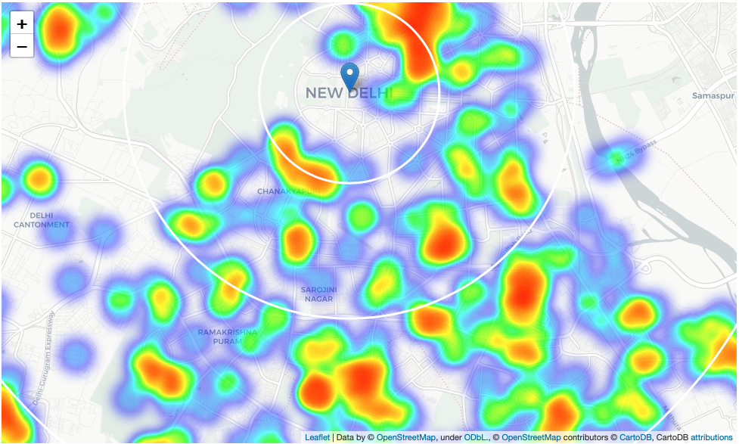
Analysis
Heatmap of all restaurants in New Delhi, with circles to show the distance from city center in the intervals of: 2km, 5km and 10km.
Here we notice some gaps in the South & South-East of New Delhi that's still close to the city center near Sarojini Nagar.

Slide 8
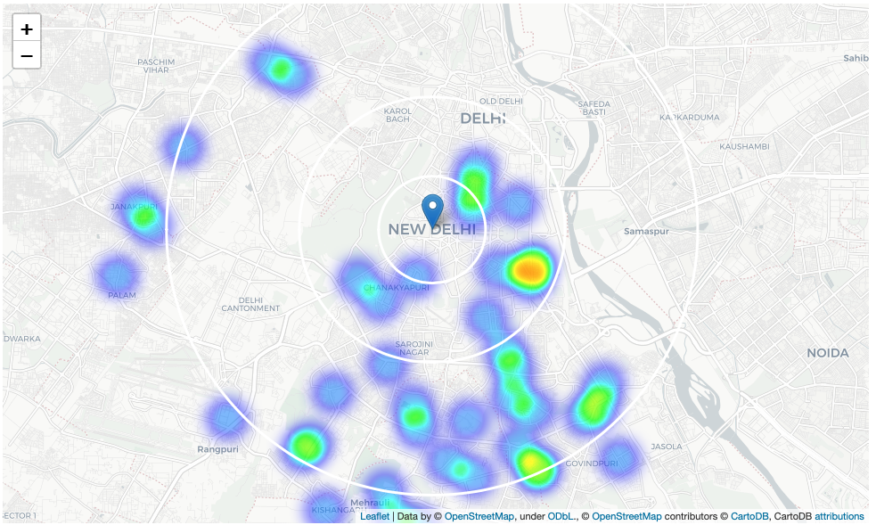
Heat Map of Italian Restaurants

Slide 9
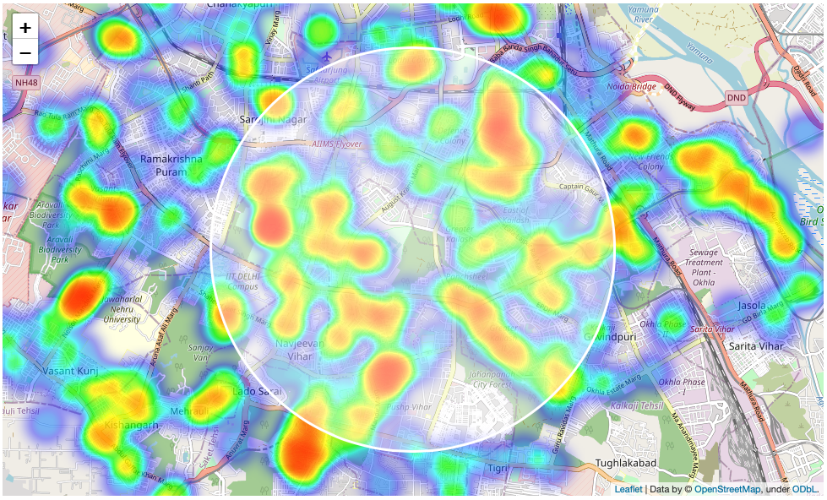
Choosing a Region of Interest for Further Analysis
The area chosen is near Sarojini Nagar in South/South-East Delhi as shown on the map.

Slide 10
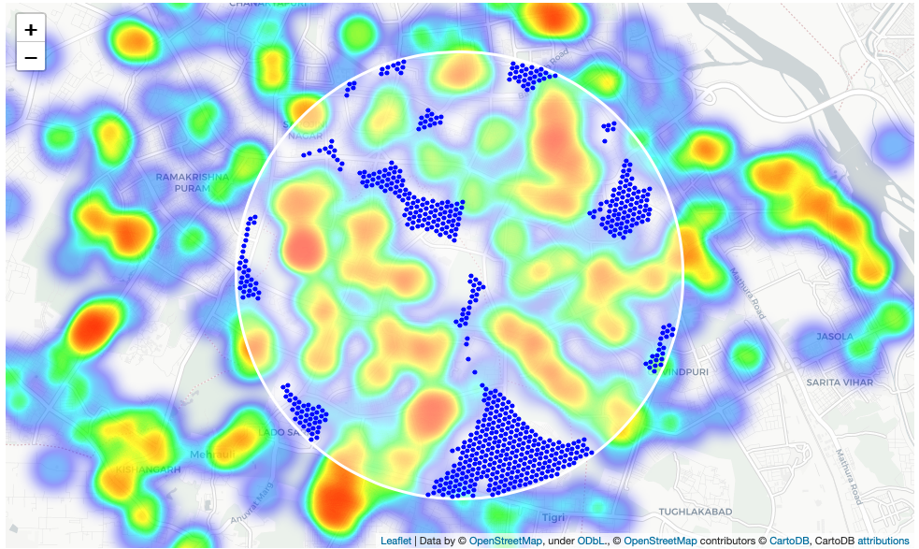
Further Analysis of ROI and Filtration of Good Locations
Good locations were filtered by the following criteria:
2 or less restaurants within 1km of the neighborhood.
No Italian restaurants within 1.5 km of the neighborhood.
These locations are visualized on a map as shown.

Slide 11
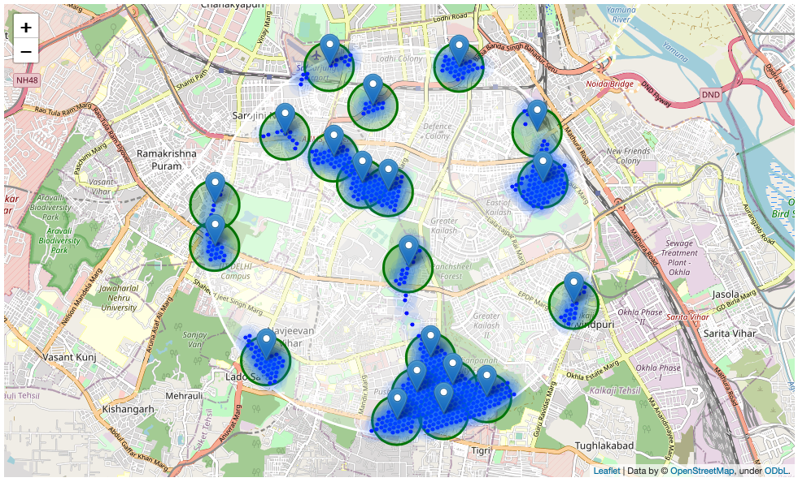
Clustering using K-means
These locations were then clustered into 20 zones using k-means as shown on the map visualization.

Slide 12
Concluding the Analysis
From the clusters we reverse geocode the centroids to obtain a final list of 20 addresses.
They are all within 18 km of the center of New Delhi, located in South & South-East Delhi.
20% of these locations are within 8km of the center.

Slide 13
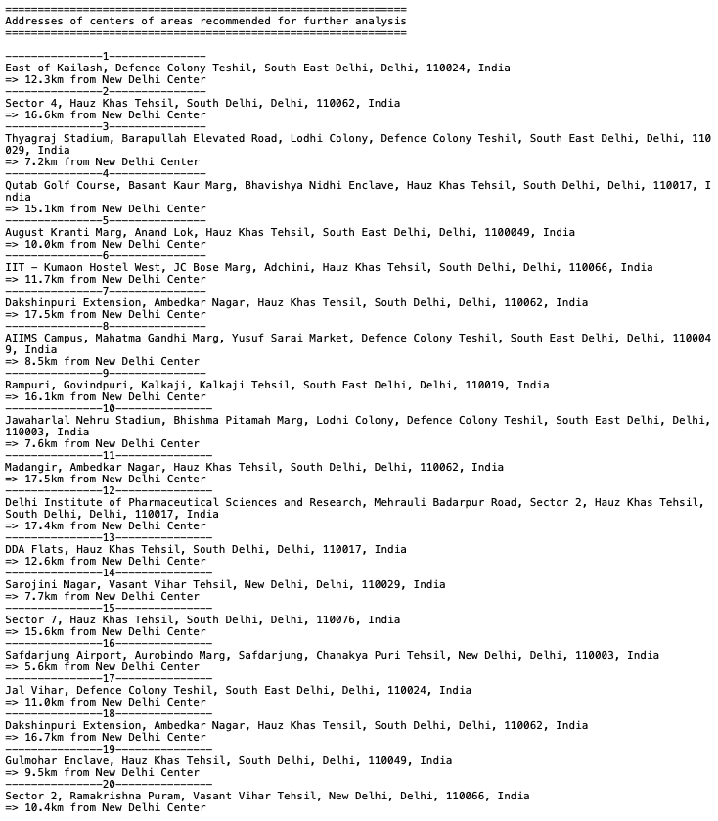
Final List of 20 Addresses

Slide 14
Results & Discussion
Our analysis shows that there are a lot of restaurants in New Delhi (within the 20km radius around the center), after further analysis it was found that an area near Sarojni Nagar in South/South-East Delhi has a lower restaurant density while also being close to the center.
This area was then further analyzed in order to determine good locations for opening an Italian restaurant. This was done by filtering locations so that good locations were those that matched the following criteria:
They had no more than 2 restaurants in a 1km radius.
They had no Italian restaurants in 1.5km radius.
Then these filtered locations were clustered using K-means which resulted in 20 clusters which we used as zones to show the general area of the good locations. Using the centroids of these zones we derived the addresses of the zones which has yielded the final list of 20 locations that are suitable for further analysis accommodating to additional factors in order to determine the viability of opening a successful Italian restaurant.

Slide 15

Conclusion
The purpose of this project was to identify areas which had a low number of restaurants and especially Italian restaurants, as these areas would be more inclined towards being a good location with low competition for opening a profitable Italian restaurant.
This was done by creating a grid of candidate neighborhoods and then extracting data on restaurants within these neighborhoods using the Foursquare API. Then upon further analysis a region of interest was determined, which was an area near Sarojini Nagar in South/South-East Delhi. Further analysis and filtration yielded possible good location that were then clustered into 20 different zones of interest and the centers of these zones were reverse geocoded to obtain a list of 20 addresses that serve as the final deliverable of the project.
These addresses can now serve as an initial starting point for stakeholders to start further analysis into the 20 areas, so that additional factors are taken into consideration, for example the existence of nearby hotels, popular attractions, real estate prices, socio-economic dynamics of the zones in order to arrive at the final best area to open an Italian restaurant. This is because this project has only considered the density of restaurants thus determining 20 areas of low competition from other restaurants and no competition from Italian restaurants.

